Slide 1

Entertainment The Lego Group
Submitted by - Sharma Nikki

Slide 2


Table of Content
Introduction
Data Analysis
ANOVA Test
Prescriptive analysis
Database & R connection
Q&A

Slide 3
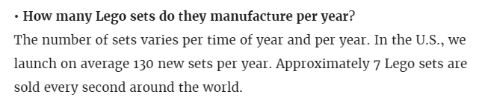

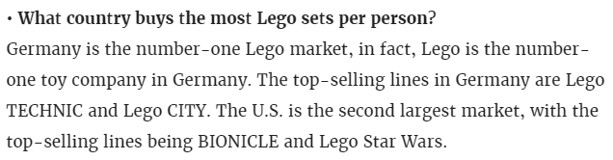

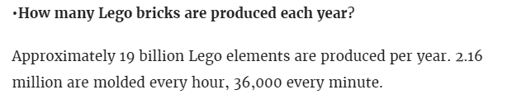
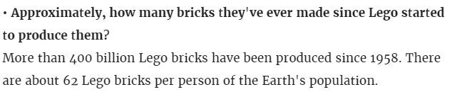
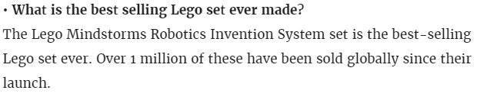
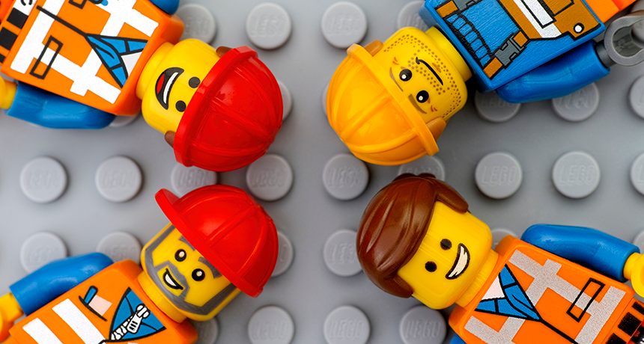

Slide 4
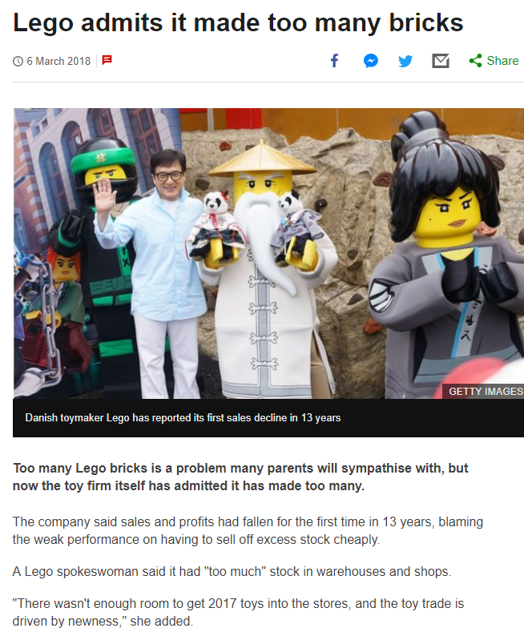
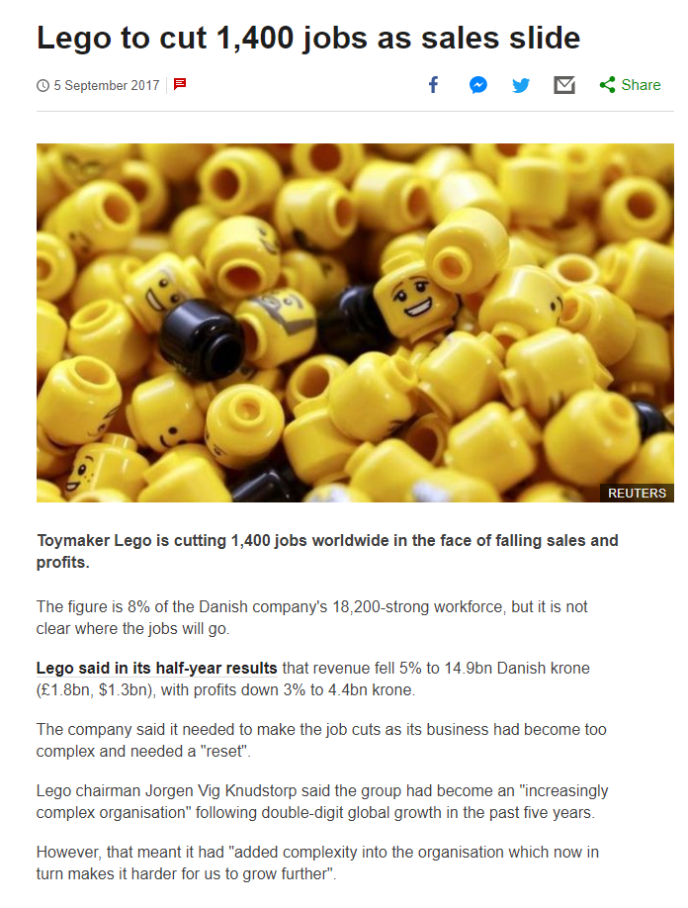
https://www.bbc.com/news/business-43298897
https://www.bbc.com/news/business-41160743

Slide 5

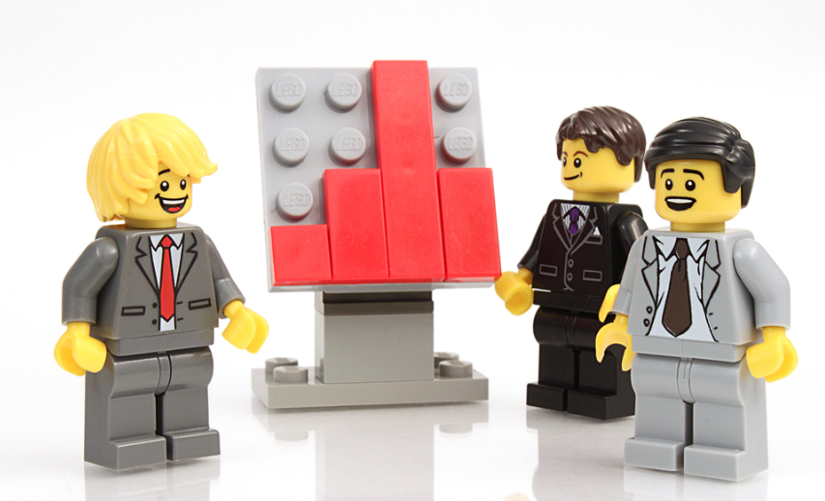
Analyzing what measures can be taken by The Lego Group(TLG) to increase its sales considering the themes and colors

Slide 6
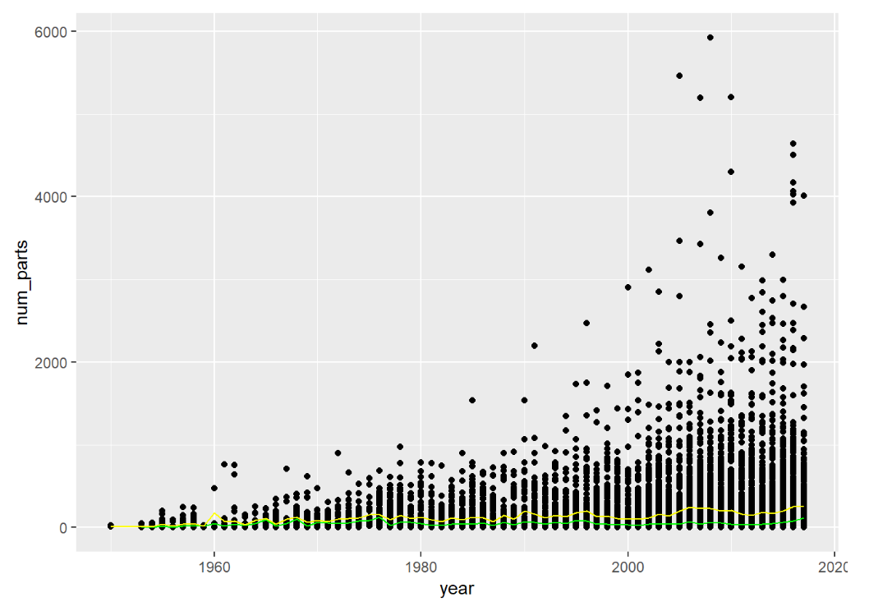
Change in Lego’s numbers of set over time
Mean
Median

Slide 7
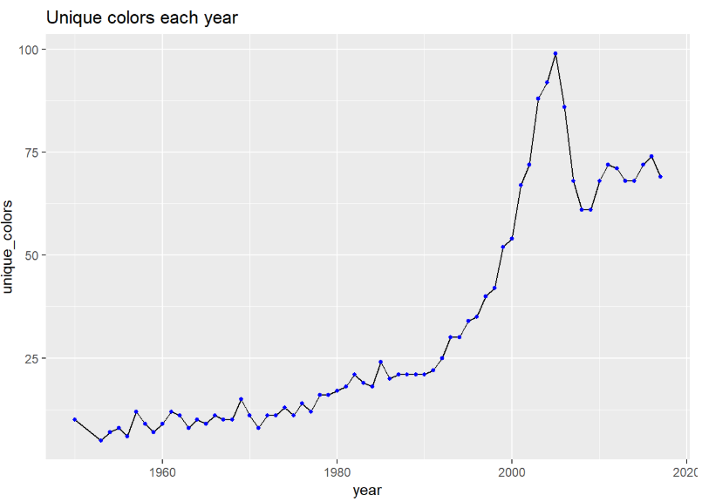
NUMBER OF UNIQUE COLORS RELEASED OVER THE YEARS.

Slide 8
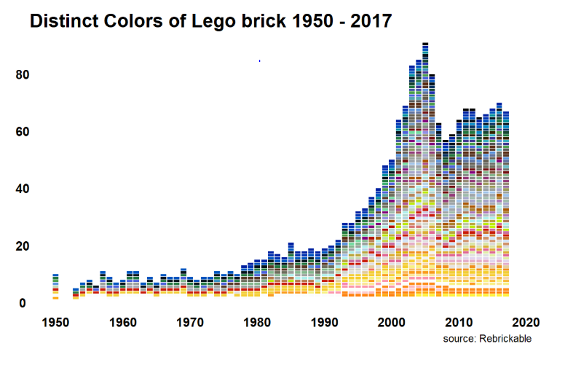

Slide 9
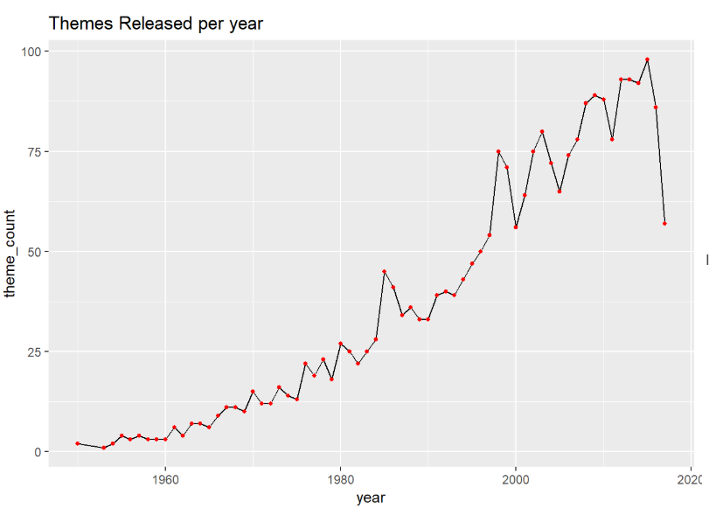
The number of themes released over the years

Slide 10
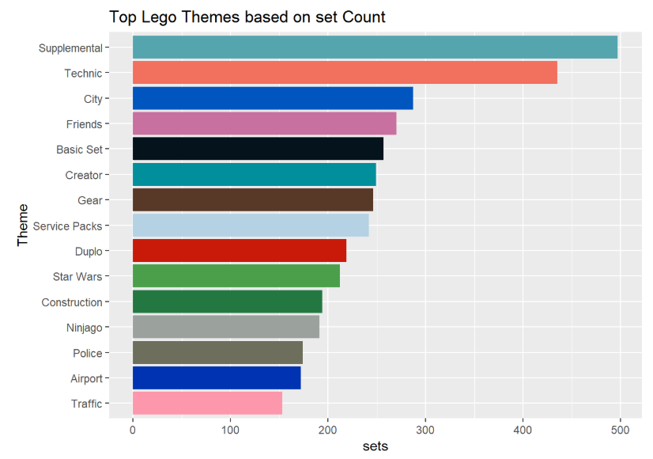
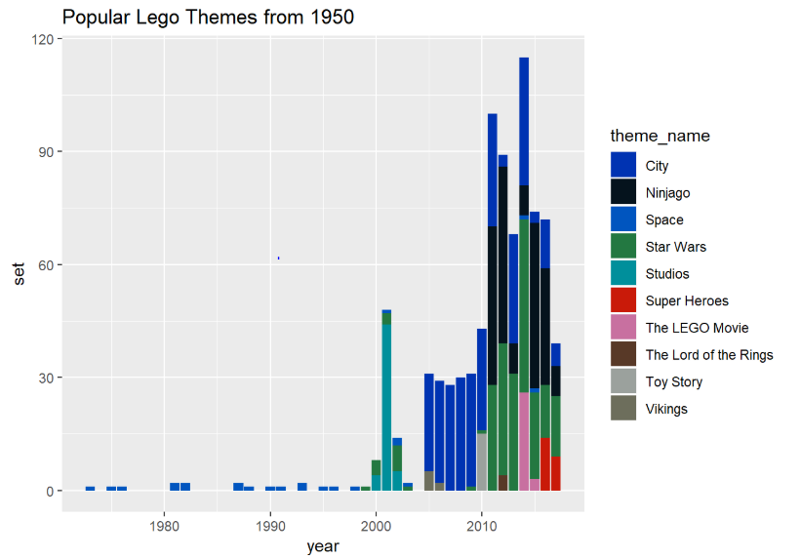
POPULAR THEMES

Slide 11
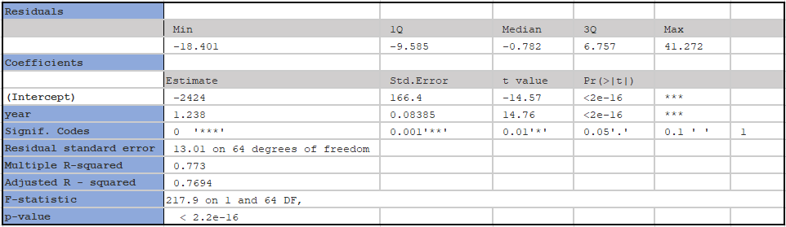
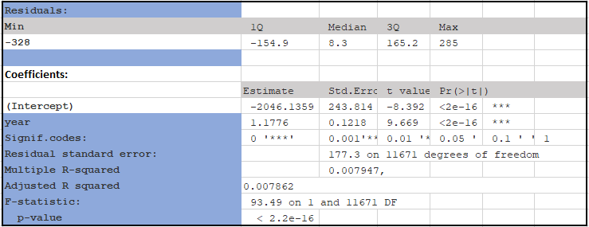
Regression Analysis - number of unique colors BY year
The p value for the coefficient for year variable is ‘<2e-16’, and thus year’s coefficient is highly significant
number of THEMEs BY year
The p value for the coefficient for year variable is ‘<2e-16’, and thus year’s coefficient is highly significant

Slide 12
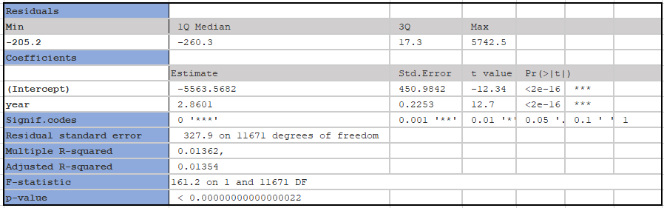
Regression Analysis
The number of parts over the year, to check if the coefficients are significant
The p value for the coefficient for year variable is ‘<2e-16’, and thus year’s coefficient is highly significant

Slide 13
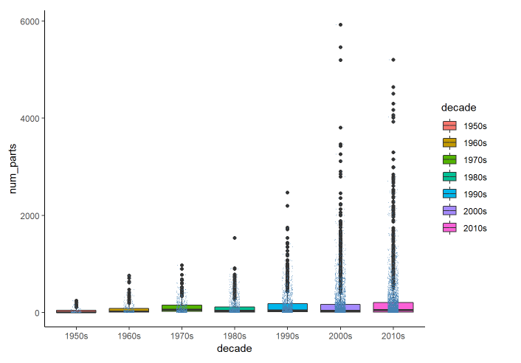
THE NUMBER OF PARTS IN SETs OVER THE DECADES & THE TREND.

Slide 14
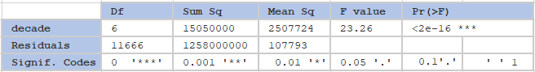
ANOVA TEST
The p-value is lower than the threshold of 0.001. It means the NULL hypothesis that there is no change over the decades is rejected.
The one-way ANOVA test does not inform which group has a different mean. Therefore using a Tukey test.
Notes:
Number of parts by decades

Slide 15
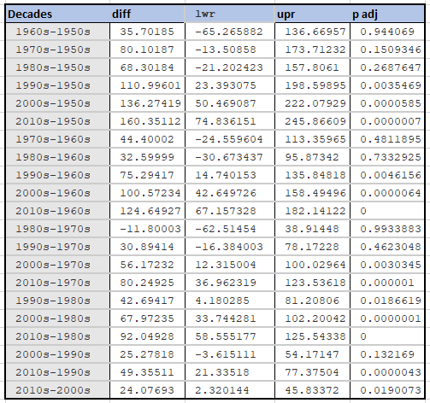
TUKEY TEST
During 1950s to 1990s, it took at least 30 years to see a statistically significant difference in the change of number of parts in sets.
However, between 1990s and 2010s, the pace of change is statistically significant in just 20 years.
Between 2000s and 2010s, within a decade there is a statistically significant change.
Thus, not only there has been change in number of parts over the decades, the degree of change seems to have increased significantly.

Slide 16
CONCLUSION
TLG must follow the movies culture more closely.
Concentrate on the AFOL (Adult Fan Group) group and online stage for new advancement thoughts
Contribute more on the R & D division
Considering showcasing effort in different nations to grow the base as that of Germany and US

Slide 17
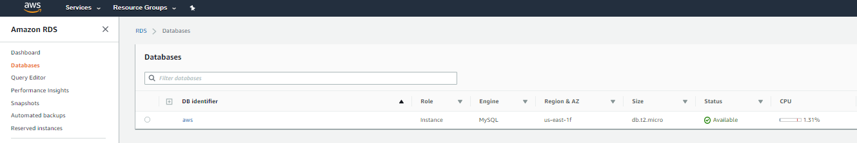
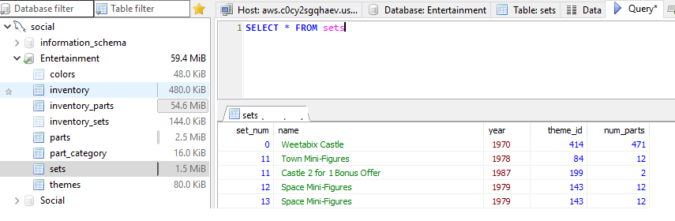
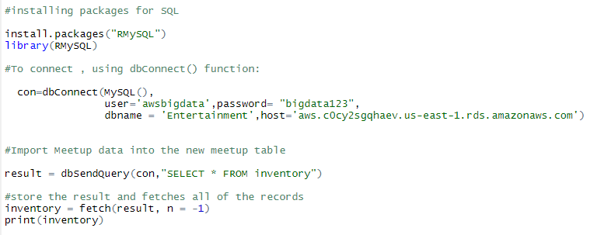
DATABASE CONNECTION & SCHEMA
Dataset Usage
The data source – Kaggle
Data is exported in csv format and is structured data
The data used is from 1950 -2017
AWS Database creation
My SQL schema
R connection

Slide 18
References
Getty Images. (2019). Retrieved from https://www.gettyimages.com/
Lego admits it made too many bricks. (2019). Retrieved from https://www.bbc.com/news/business-43298897
Us, A., Group, L., Library, M., Us, A., & 2018, T. (2019). The LEGO Group returns to growth in 2018. Retrieved from https://www.lego.com/en-us/aboutus/news-room/2019/february/annual-results-2018
(2019). Retrieved from https://gizmodo.com/everything-you-always-wanted-to-know-about-lego-5019797

Slide 19


